Slide 1
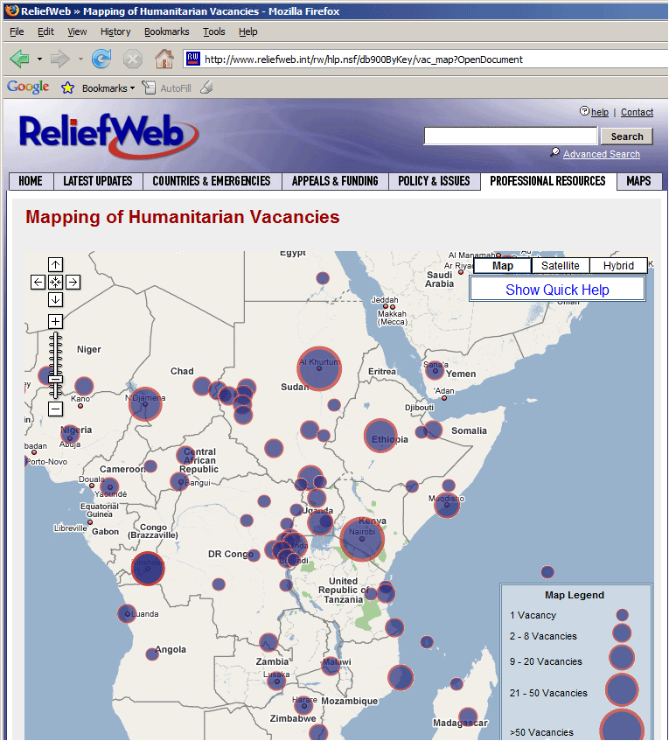
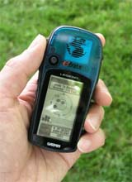
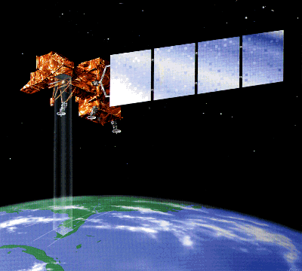

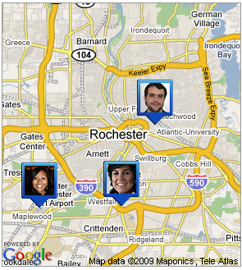
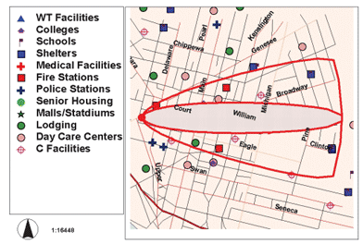
IGME - 382 - Introduction to Geospatial Technology
Fall 2021

Slide 2
Class Overview
Overview of Geospatial Technologies
Spatial Thinking
Sense of Place

Slide 3
Contact Information
Instructor: Justin Cole, GISP
Email: jdcgla@rit.edu
Twitter: @JustinColeGIS
Office Hours: https://calendly.com/jdcgla/office-hours

Slide 4
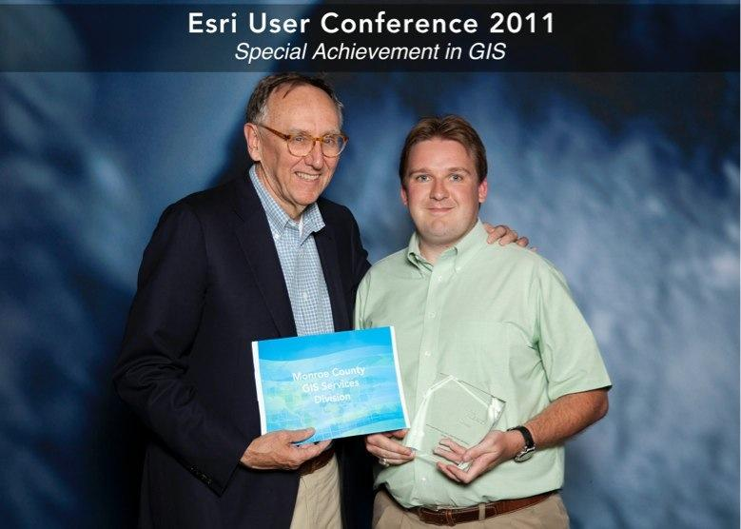
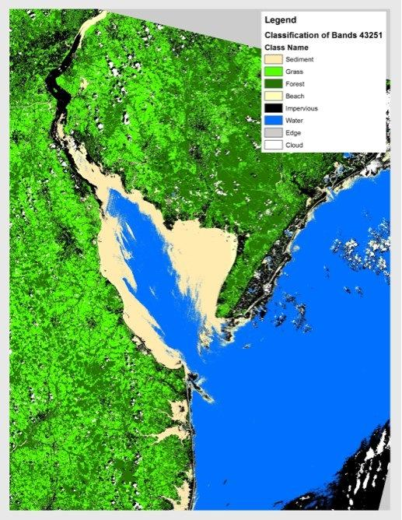
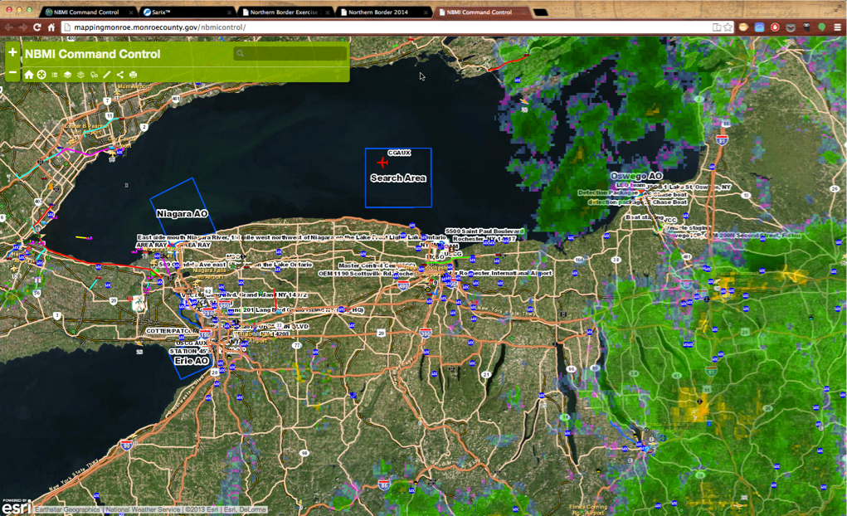
My Background
Masters from RIT in 2007 in Environmental Science
Worked for Monroe County Since 2003-2016 in the GIS Division
Worked in Consulting
Currently Full Time Faculty at University of Wisconsin and Adjunct at RIT, MCC, and Columbia College (SC)
Part of many GIS organizations such as GISSIG(current President), ASPRS, NYSGIS Association, Society for Conservation GIS, and GISCorps Member

Slide 5
Major Course Topics
Fundamentals and principles of Geographic Information
Representing Geographic Information
Survey of Geospatial Technologies (GTs) and how they work
Applications of GTs to geographic problems
Ubiquitous GTs

Slide 6
Tentative Course Schedule
Course Outline
WEEK | TOPICS
1 | Course Introduction and Overview of Geospatial Technology
2 | Geographic Information
3 | Projections
4 | Cartography and Tables
5 | GPS And Web Apps
6 | Story Maps and Census
7 | Remote Sensing / UAVs
8 | Midterm Review - Geodesign - Project Introduction and Proposal Writing
9 | Midterm
10 | Geoprocessing and Python
11 | Geodatabase Design and Editing
12 | Geodatabase Design and Editing Continued
13 | Ethics
14 | Programing your Own Application
15-End | Final Projects

Slide 7
Assumptions
Basic Windows operating systems use
Basic file management skills – download and unzip
Internet Use
myCourses

Slide 8
Textbook and Readings
Recommended: Getting To Know ArcGIS Pro 2.6
Readings to be assigned by Instructor as needed.

Slide 9
ArcGIS License
You should receive an email from ESRI or ArcGIS Online. This is important as it is you license and access to the software for the class and ArcGIS Online
The account is tied to your RIT login
Our Organization is ritarcgis

Slide 10
Tips for success…
Do the readings and follow the lectures
Develop self-help skills
Develop time management skills
Develop writing skills
Ask questions
Share resources and work together (email/discussion board)

Slide 11
Overview of Geospatial Technologies
Technologies that represent the Earth
Information used to create those representations
Geographic or Geo-Information

Slide 12
What’s in a Name?
Geospatial synonymous with Geographic
Geospatial adopted by non-academics
Geospatial implies more emphasis on tools, information

Slide 13
What’s in a Name?
Term variations
Geo-Information Technology (European)
Geospatial Technology
Geospatial Information Technology
Geographic Information Technologies
Geomatics
Geoinformatics

Slide 14
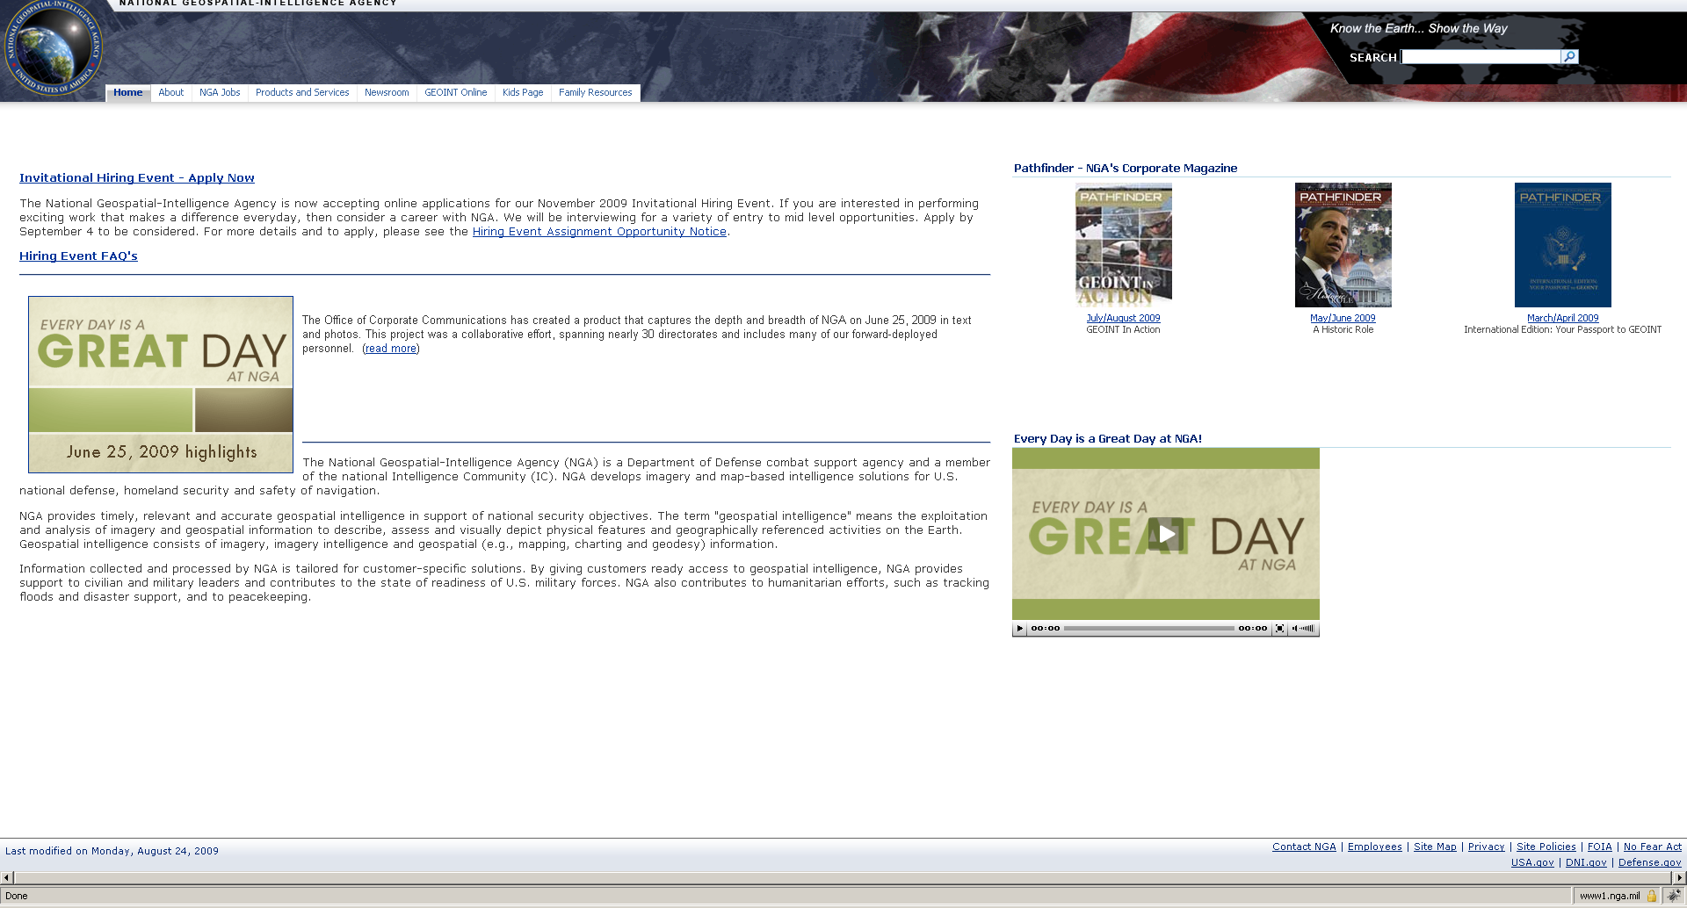

Slide 15
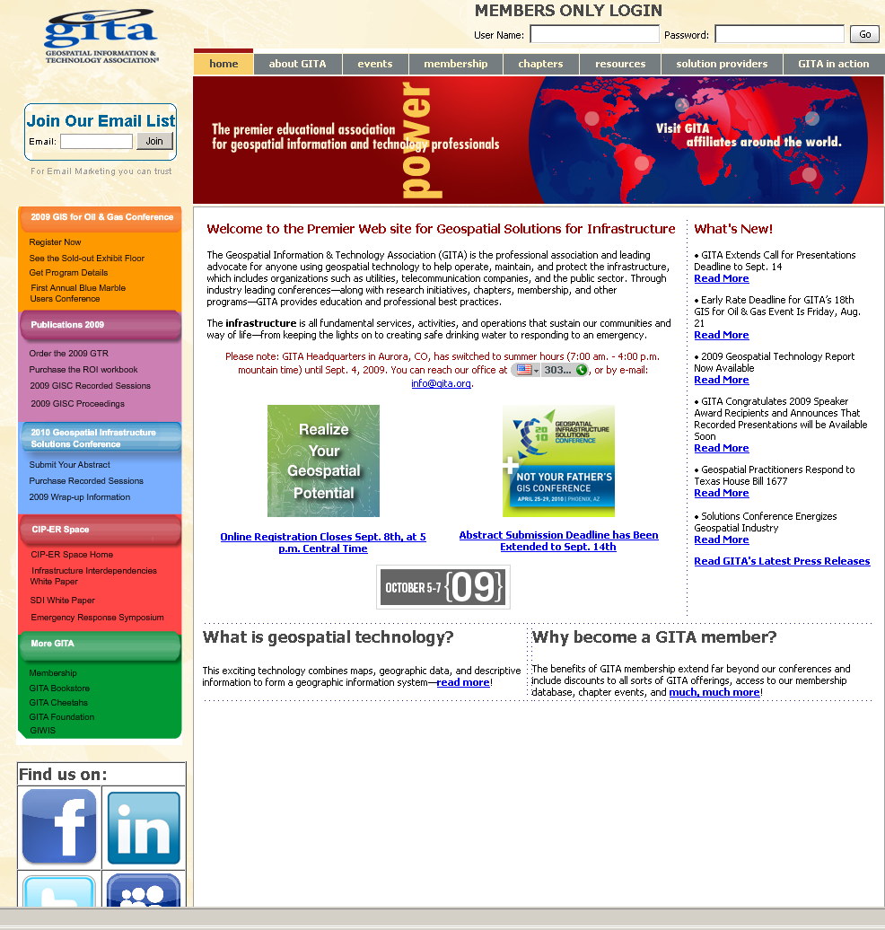

Slide 16
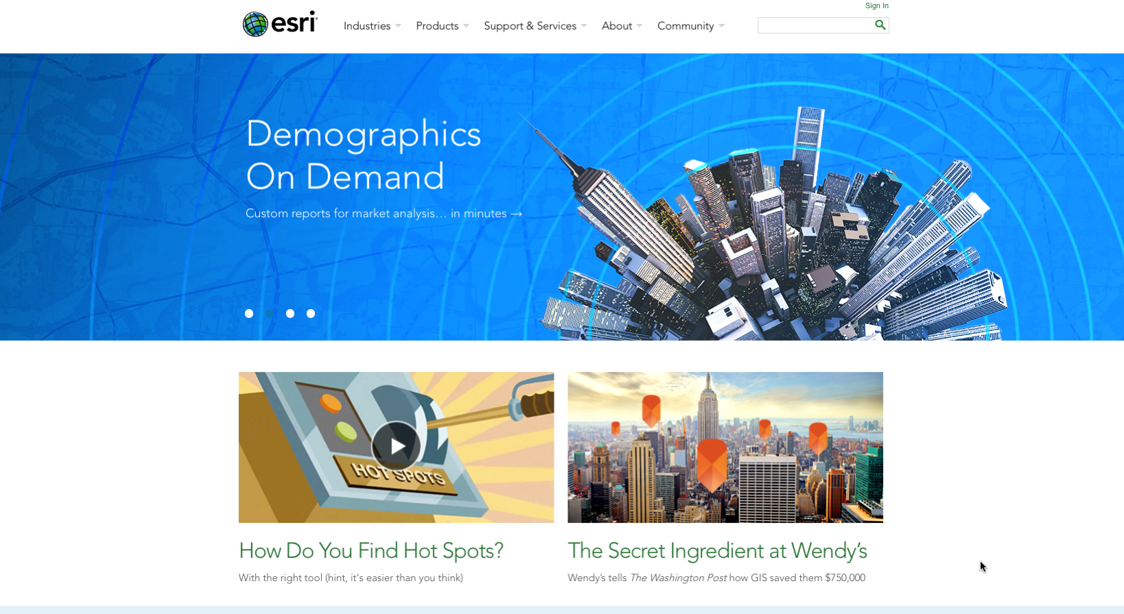

Slide 17
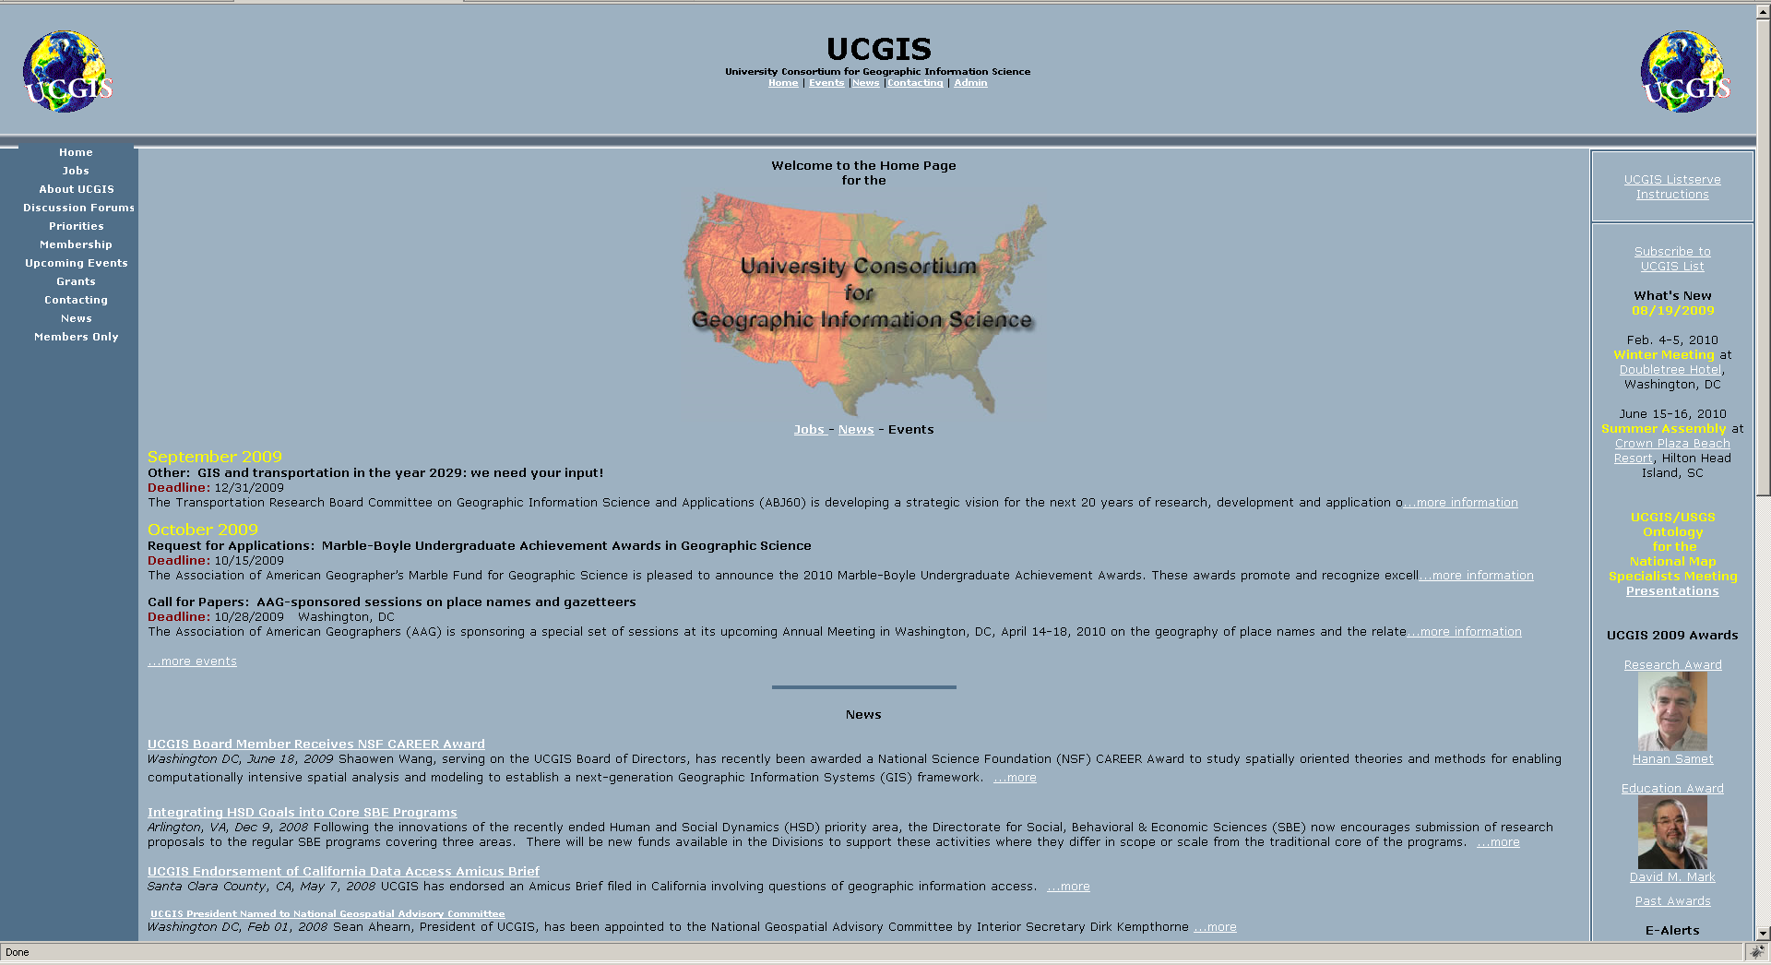

Slide 18

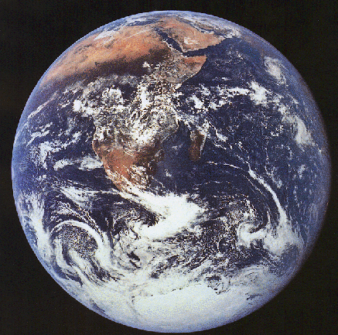
Geo-information Technologies
Geo = The earth (geography, geology)
Information = data with context
Notes:
Describing in the earth

Slide 19

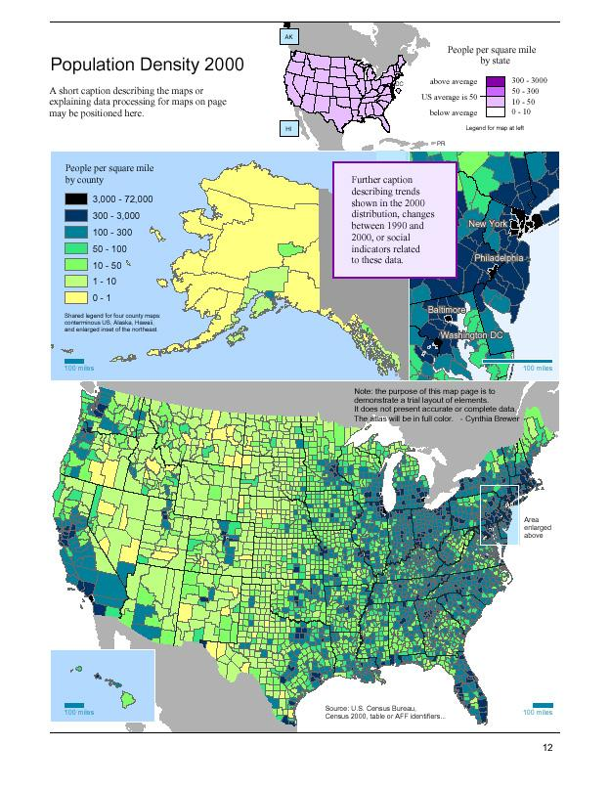
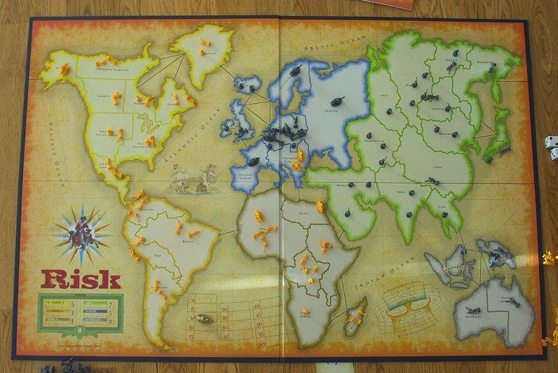
Geo-information Technologies
http://upload.wikimedia.org/wikipedia/commons/d/db/Al-Idrisi%27s_world_map.JPG
Notes:
Many ways that geo-information can be represented
Traditional and un-traditional

Slide 20
Geospatial Technologies
Maps have been used for centuries
Fundamental purpose of modeling the Earth
Decision making, spatial reasoning
Computing age
New technologies that represent G.I.
New issues
Notes:
Go over some of the core GI technologies that new ubiquitos technologies come from

Slide 21
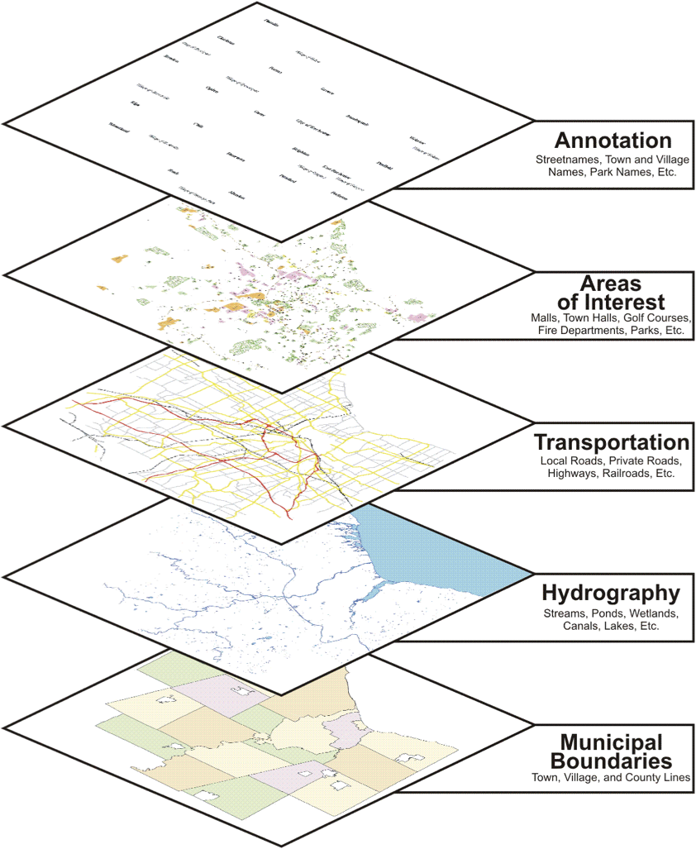
Geographic Information System
GIS
Combines layers of information (data) to have better understanding of a location
Requirements:
Hardware
Software
Data
People
Training
Notes:
GIS – slice the world into layers
“classic” standard approach for digital mapping
Big industry, lots of jobs
Lots of applications

Slide 22
Plume Impact
http://www.esri.com/news/arcuser/1003/plume1of2.html
Notes:
Emergency response
BT work – spatial query

Slide 23
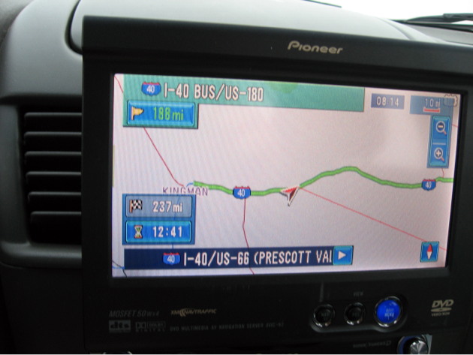

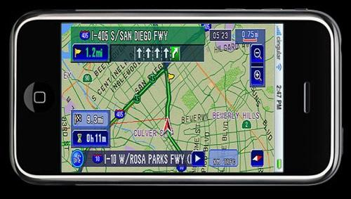
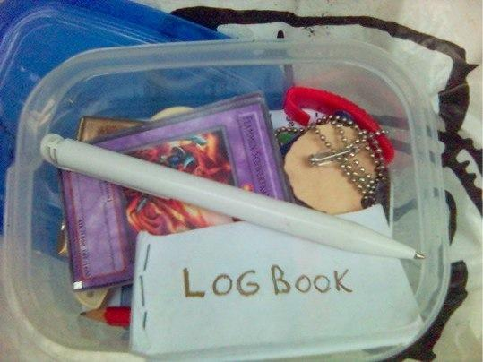
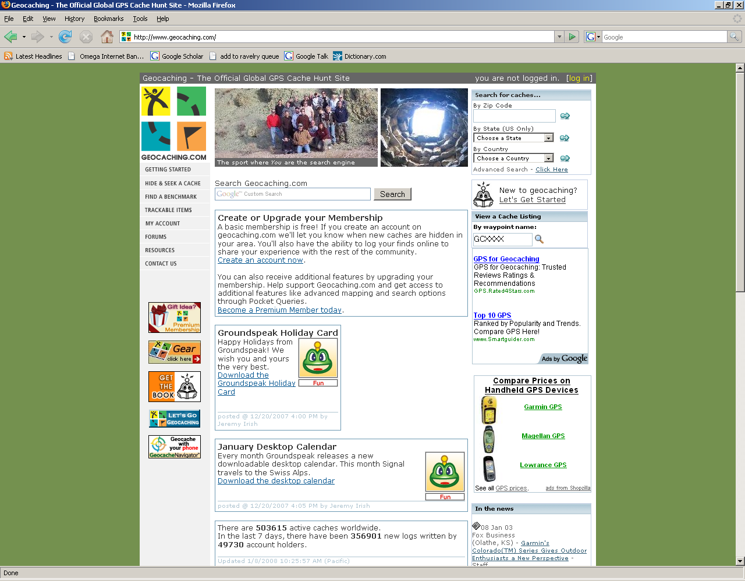
Global Positioning System (GPS)
Notes:
Might be familiar
Anyone geocache?
Example of a military technology for civilian use
Create geo-communities discussed later

Slide 24
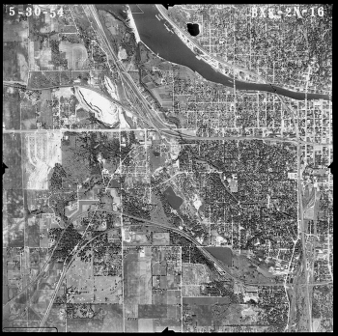
Remote Sensing
Notes:
Viewing the earth from space/sky
Many applications
Seeing lots of area

Slide 25
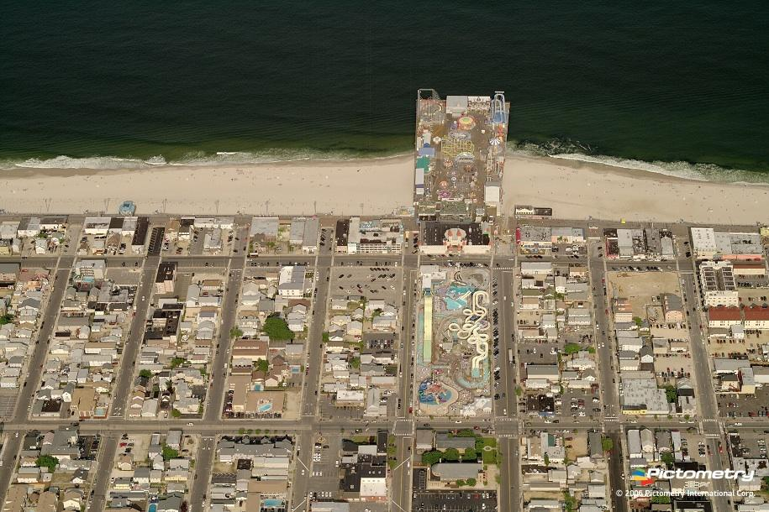
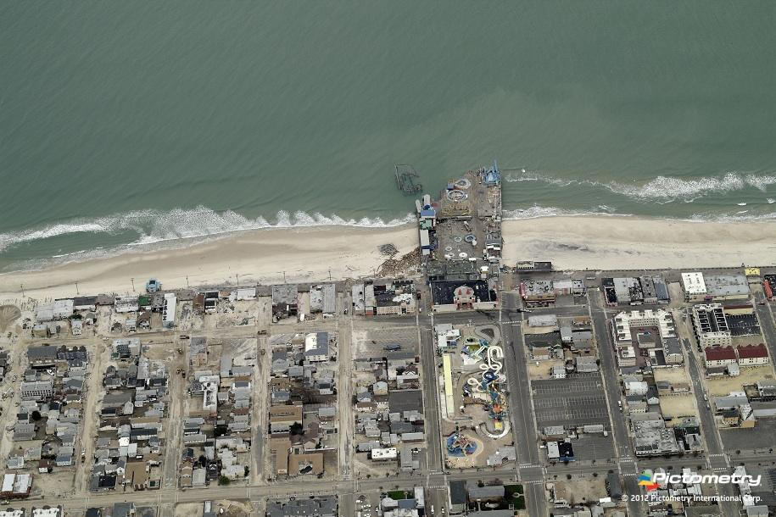

Pre and Post Hurricane Sandy
Pictometry Imagery of Seaside Heights, NJ
Boardwalk
http://www.fastcoexist.com/1680903/the-amazing-aerial-photos-of-sandys-destruction-that-are-helping-rebuild-the-region#1

Slide 26
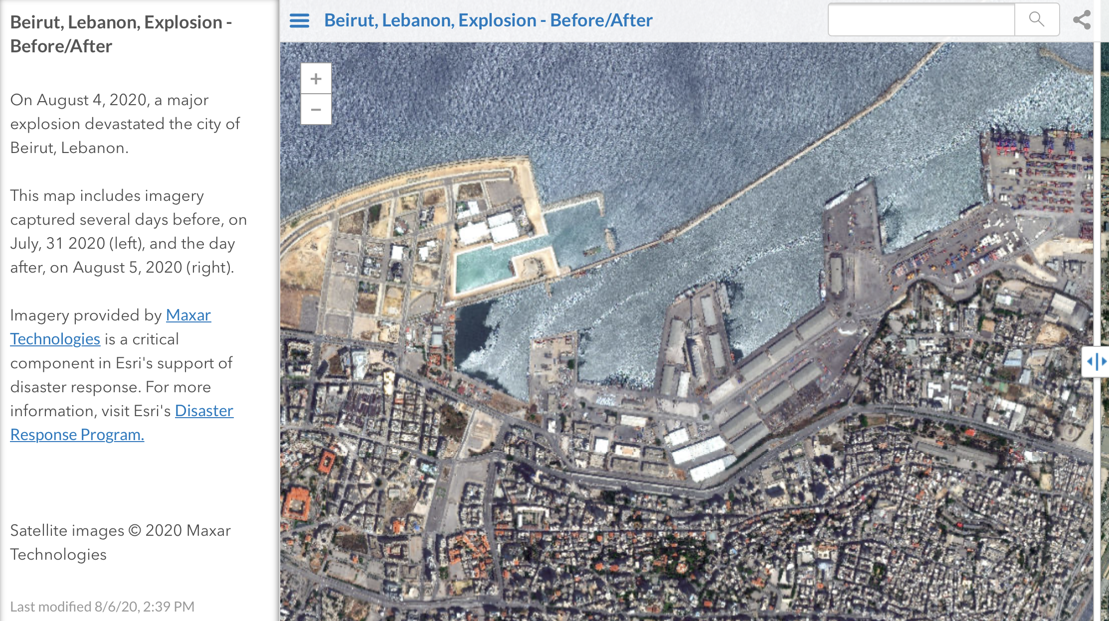
https://esri.maps.arcgis.com/apps/PublicInformation/index.html?appid=365bc49221cc4969afd773715abb6bdb

Slide 27
21st Century Developments with Geospatial Technologies
More maps created and used by non-specialists
More applications emphasizing place/location (Google etc)
Ubiquitous Mapping
Notes:
Facebook, blogs, wikipedia etc
So called “web 2.0” –user created content
Wider spread availability of technology

Slide 28
Ubiquitous Mapping
“the use and creation of maps by users anywhere and at anytime” – Morita (2005)
Mapping “everywhere”
Integrated more into daily life cell phones, PDAs etc

Slide 29
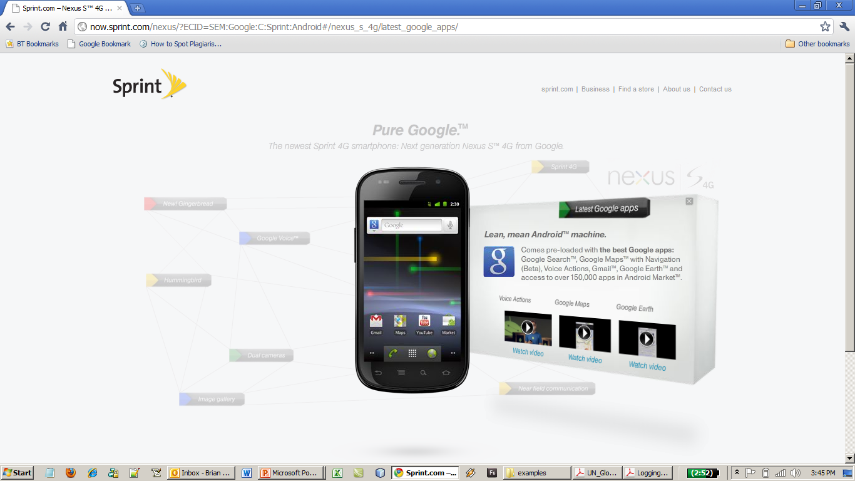

Slide 30
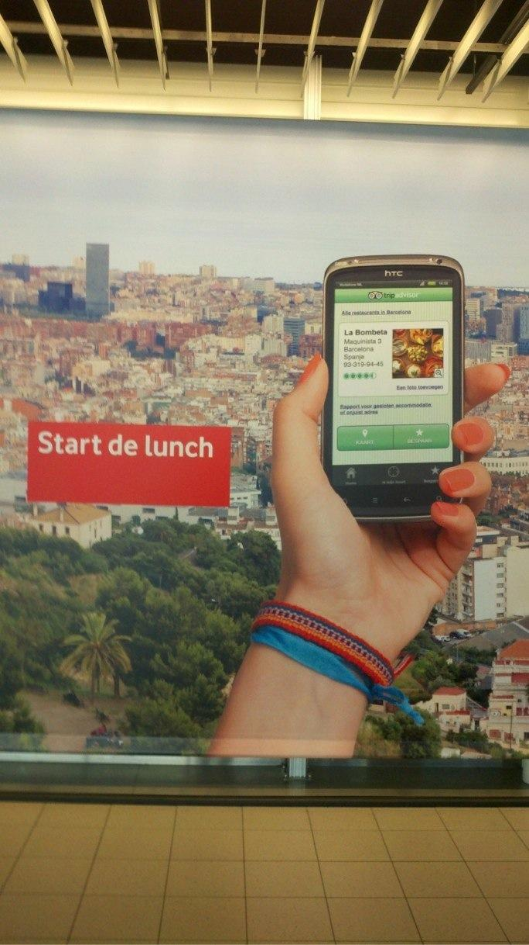


Slide 31
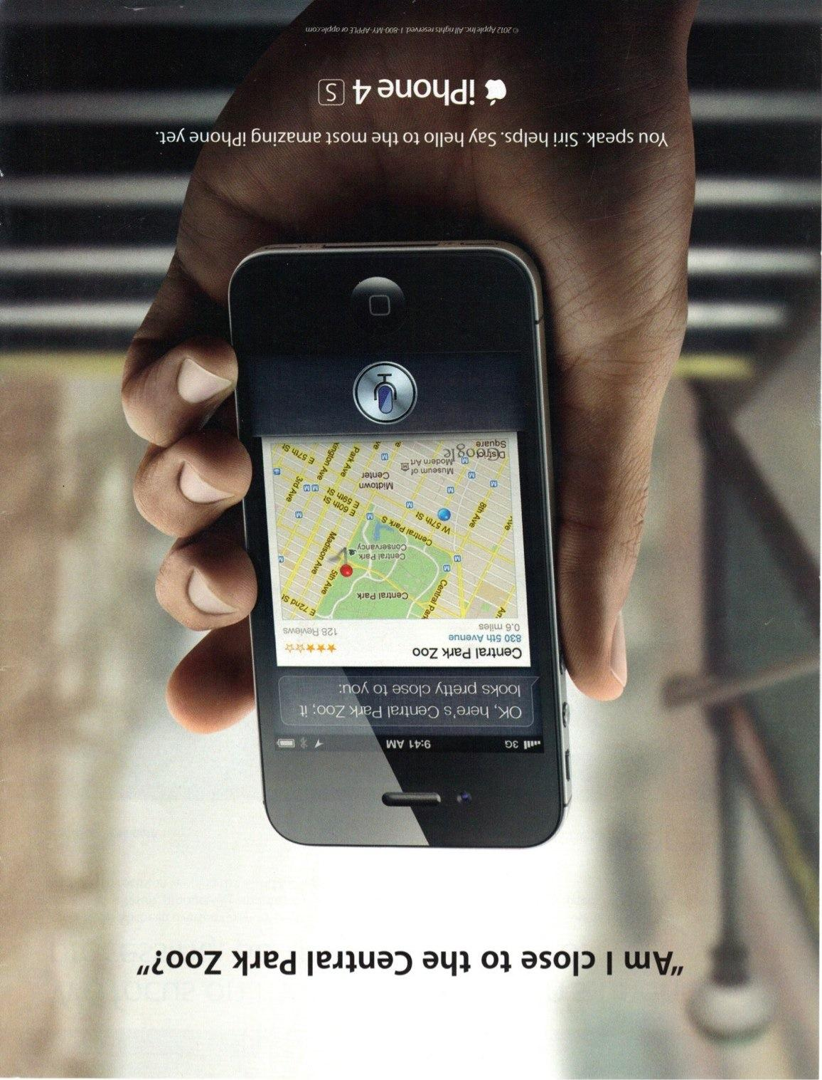

Slide 32
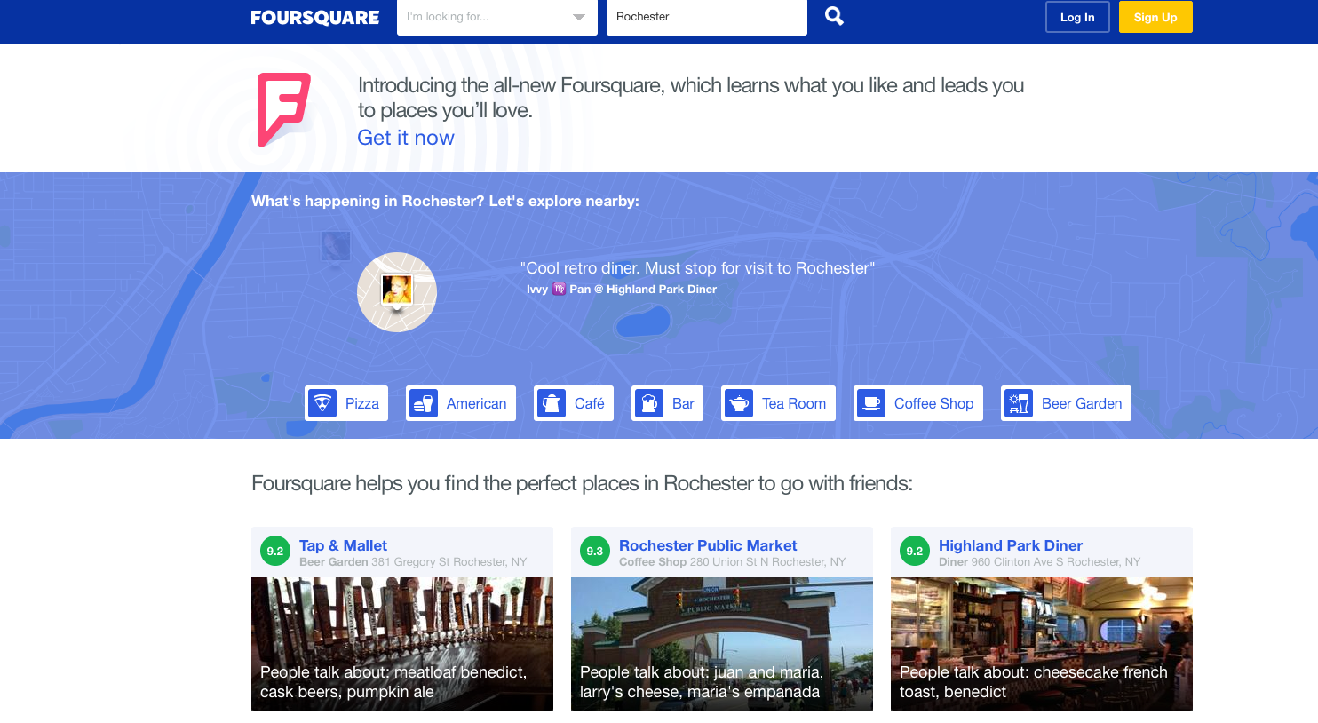
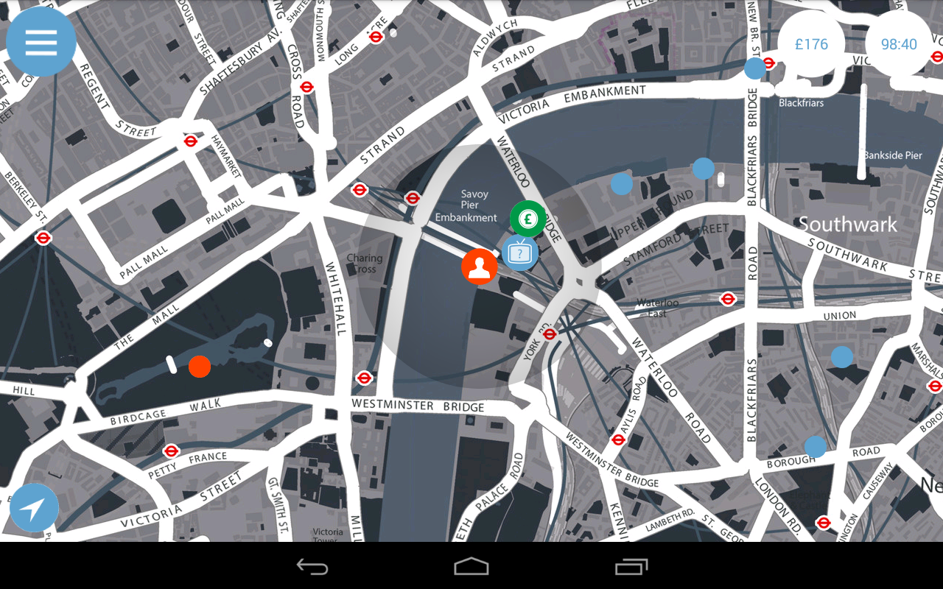
Geospatial Tech. and Gamming
http://foursquare.com/
Sherlock - The Network

Slide 33
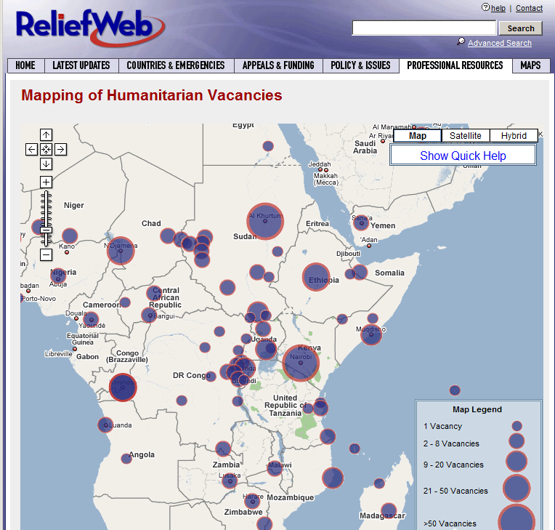
Mapping Mashups
Tomaszewski, B. (2009). Managing Multiple Point-based Data Instances on a Single Coordinate in Mapping Mashups. Paper presented at the Proceedings of the 24th International Cartography Conference (ICC), Santiago, Chile.
Notes:
Huge boom - anyone not seen google maps?
Mixing content that normally is not together
Most data has a location component
Good example of mapping that can be done by anyone

Slide 34
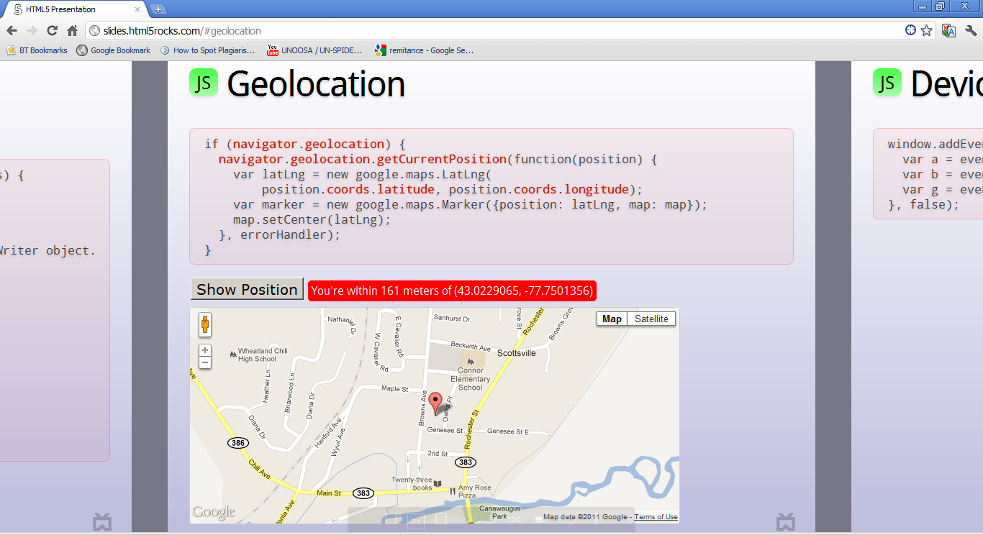
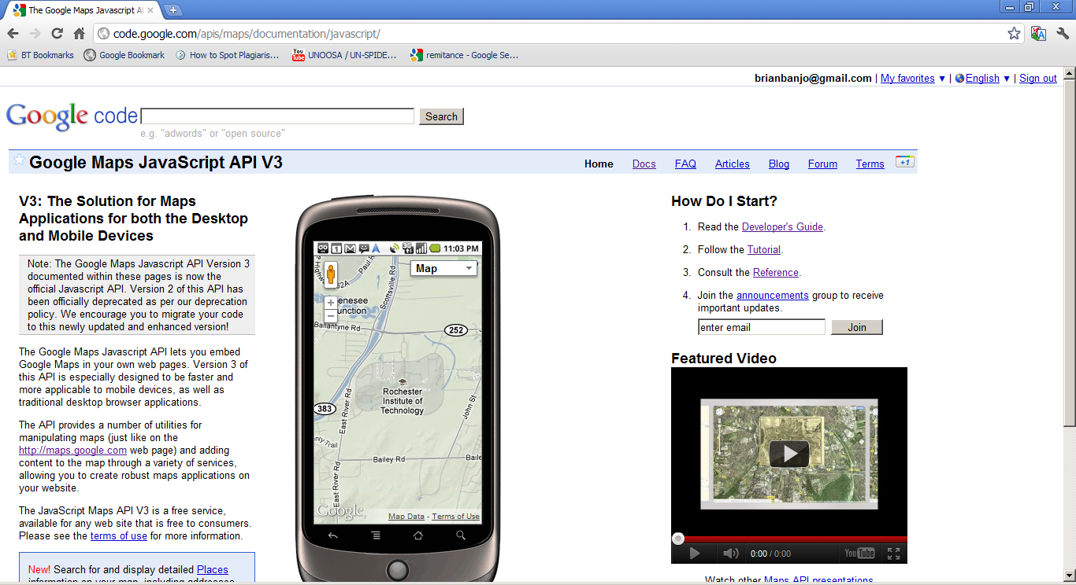
Mapping Mashups – HTML 5/Mobile

Slide 35
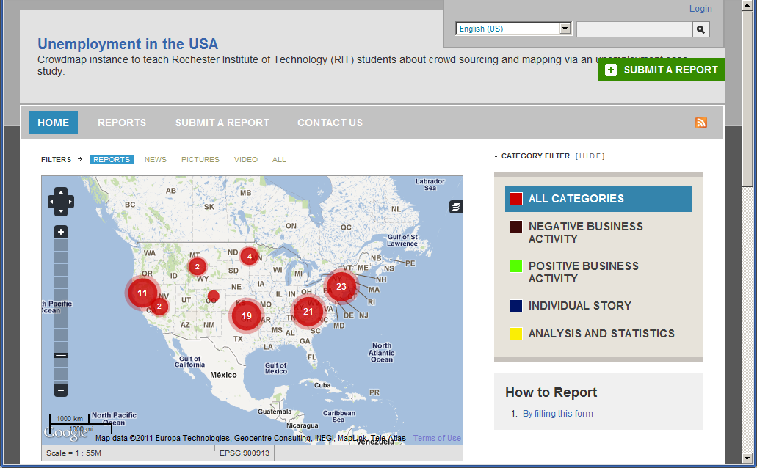

Slide 36
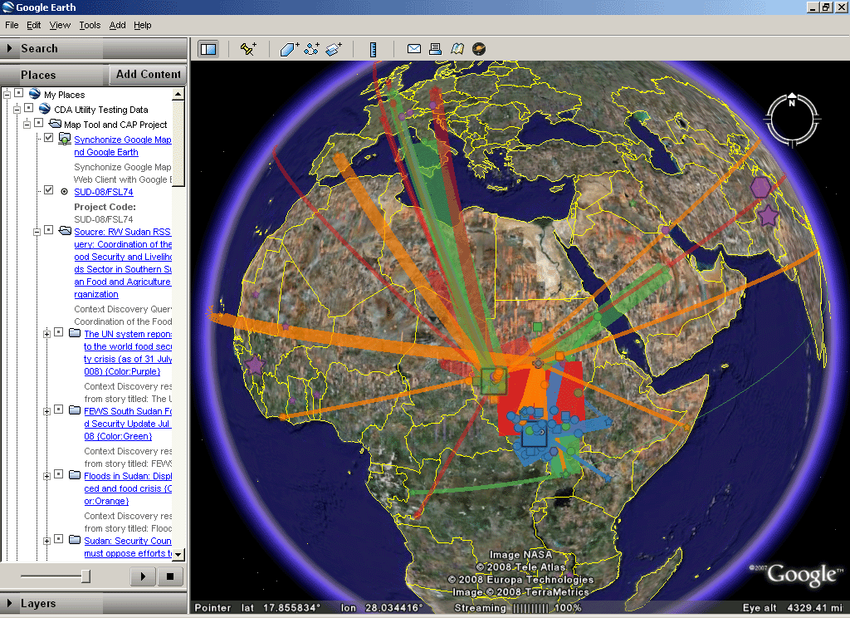
Virtual Globes - Google Earth
B. Tomaszewski, "Situation Awareness and Virtual Globes: Applications for Disaster Management," Computers and Geosciences, vol. 37, pp. 86-92, 2011.
Notes:
Anyone not used GE?
Easy to use (video game)
Makes geography cool!

Slide 37
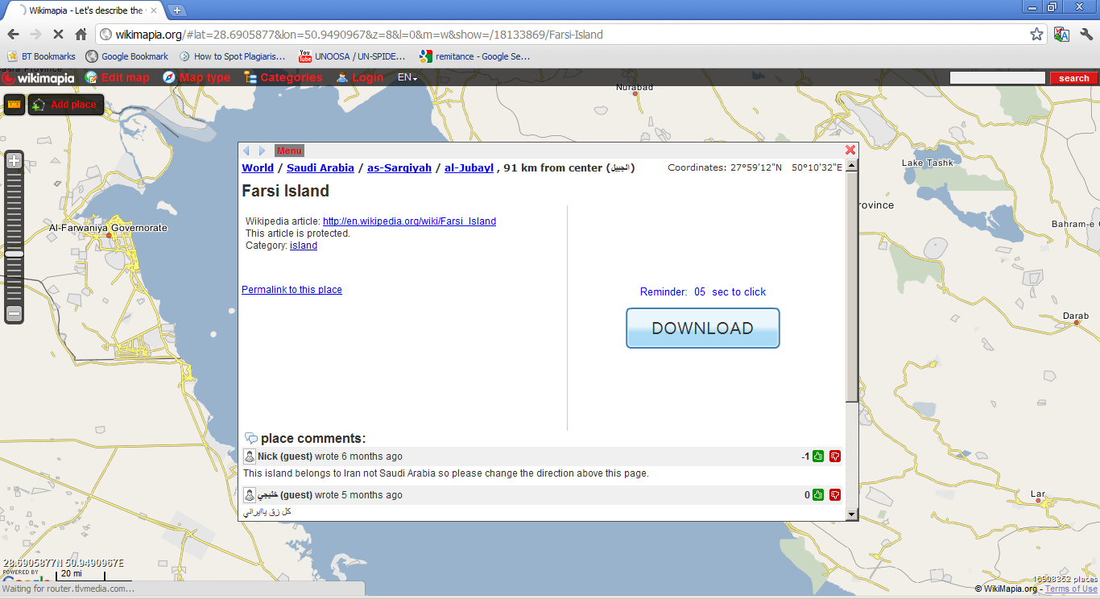

Slide 38
Social Implications
Interaction with/understanding of people and places
Privacy
Accuracy
Re-enforcing existing social orders
Other?
Notes:
Just a few of the issues
Think during talk, ideas for others

Slide 39
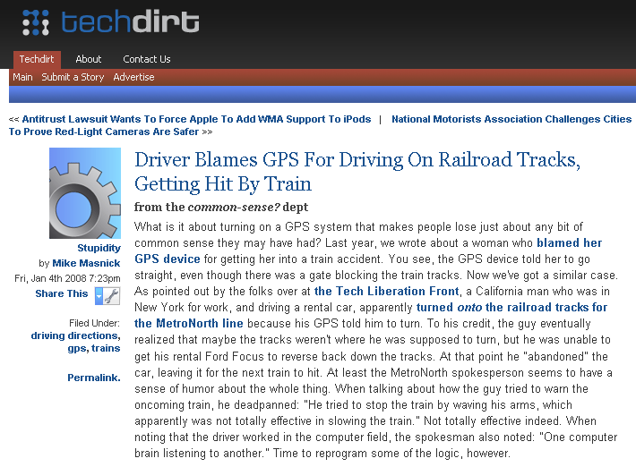
Notes:
Overreliance on technology
Machines do the thinking for us?

Slide 40
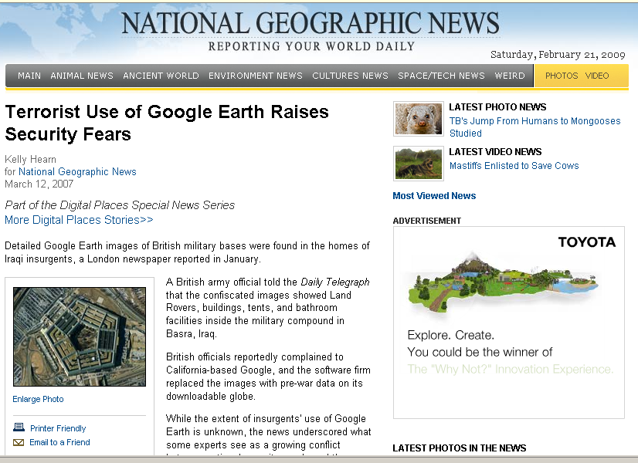
Notes:
Privacy and security – what should be public and who gets to see/use it?

Slide 41
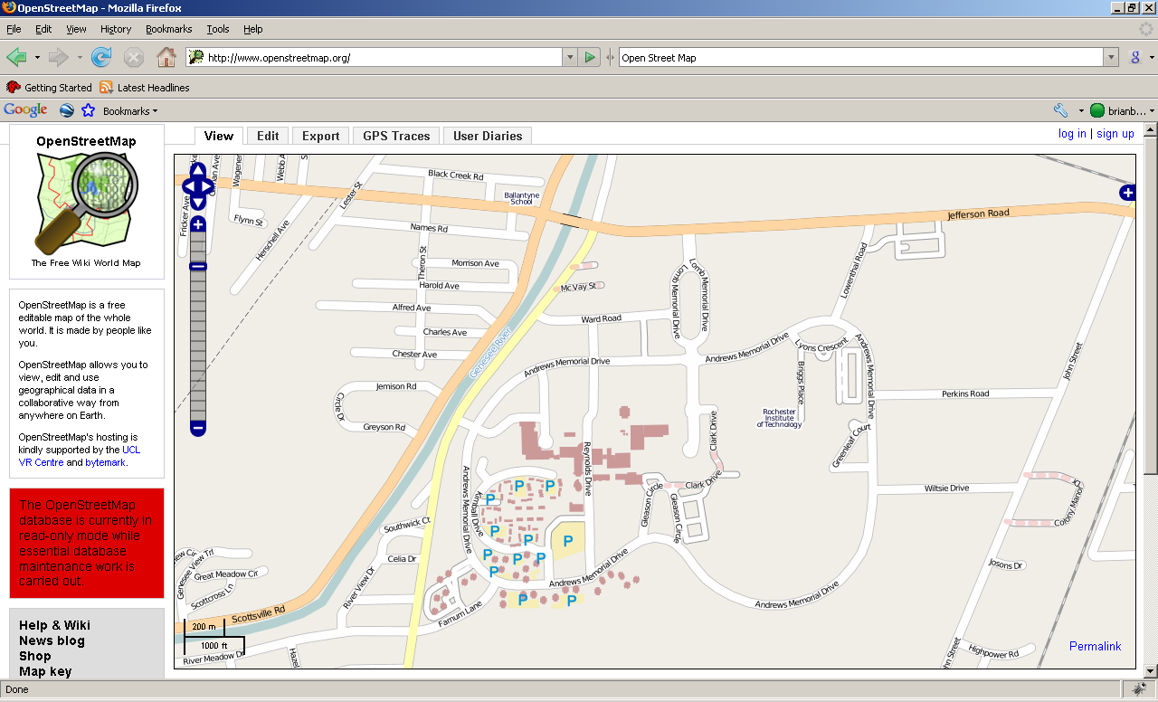
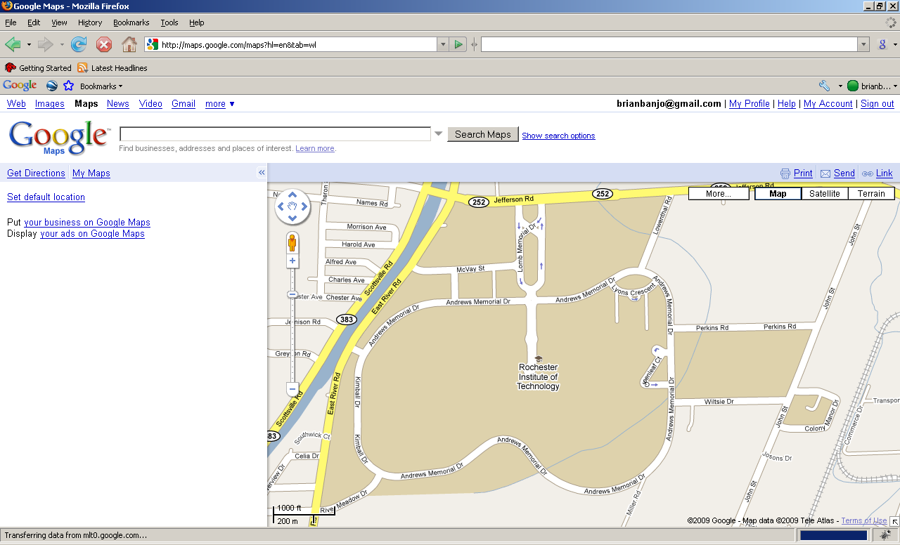
Open Street Map
Which one is accurate?
Google Maps
Notes:
trust, ownership, accountability

Slide 42
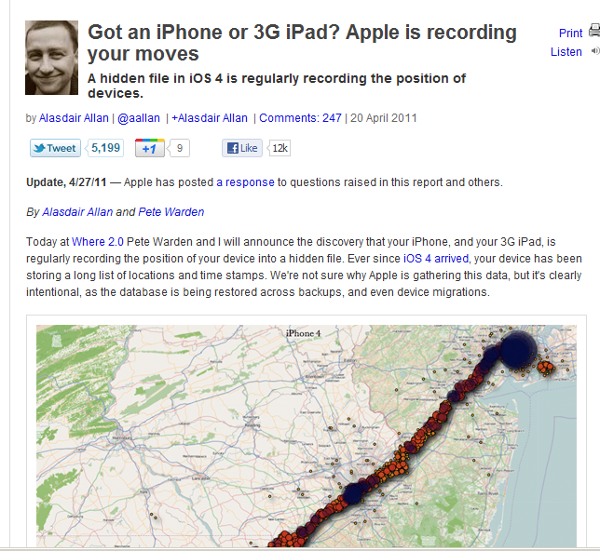
http://radar.oreilly.com/2011/04/apple-location-tracking.html

Slide 43
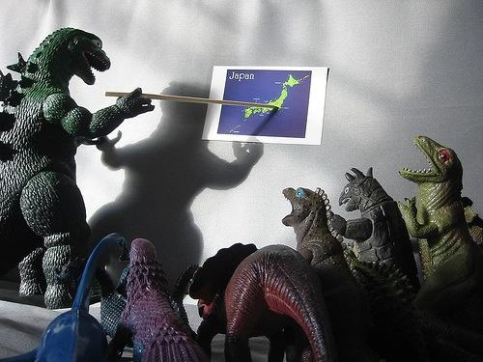
Spatial Thinking

Slide 44
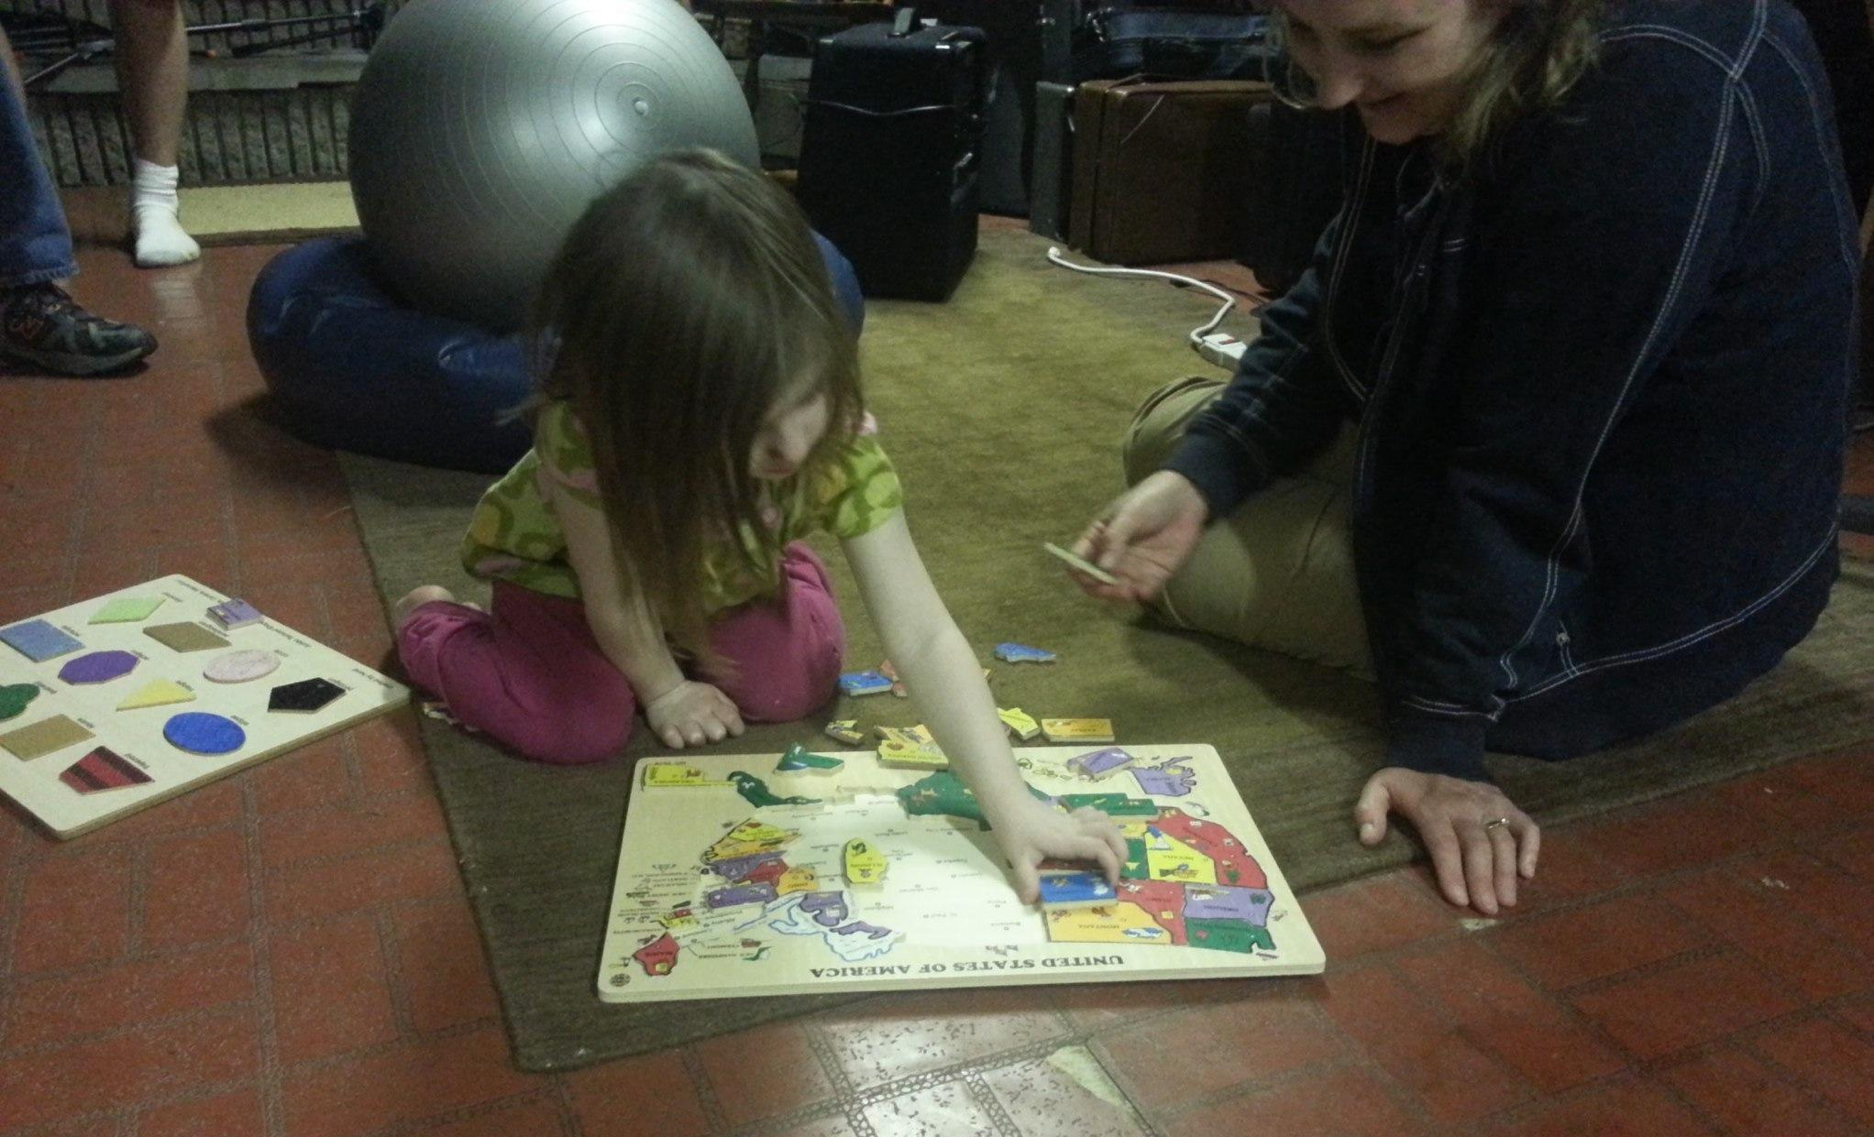
We learn spatial thinking starting at a young age..

Slide 45
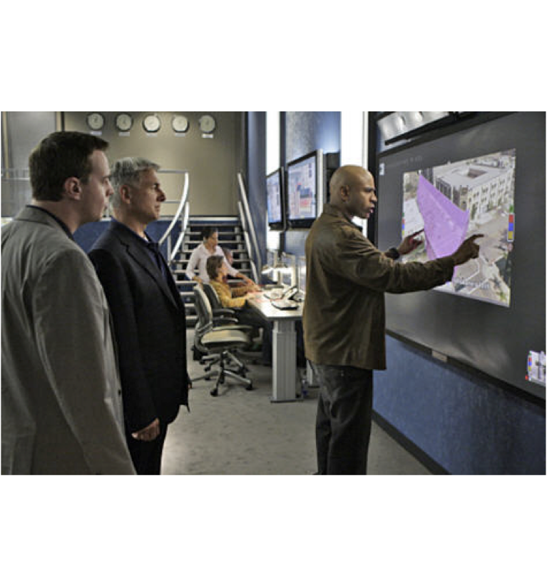
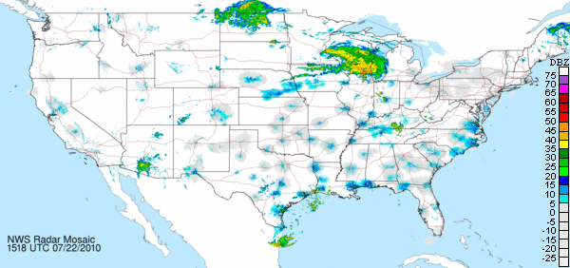
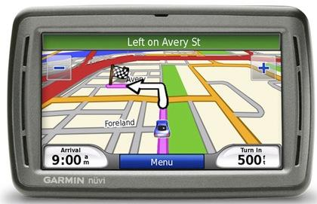
A Lot of Exposure to Geospatial
Information Every Day
© 2009 CBS Entertainment found on
http://www.nycgameindustry.com/ncis-features-forterra-systems-technology/

Slide 46
What is Spatial Thinking?
Elements of Spatial Thinking:
1. concepts of space
2. tools of representation
3. processes of reasoning
National Research Council 2006. The Nature of Spatial Thinking. Learning to Think Spatially: GIS as a Support System in the K-12 curriculum. Washington, DC: The National Academies Press.

Slide 47
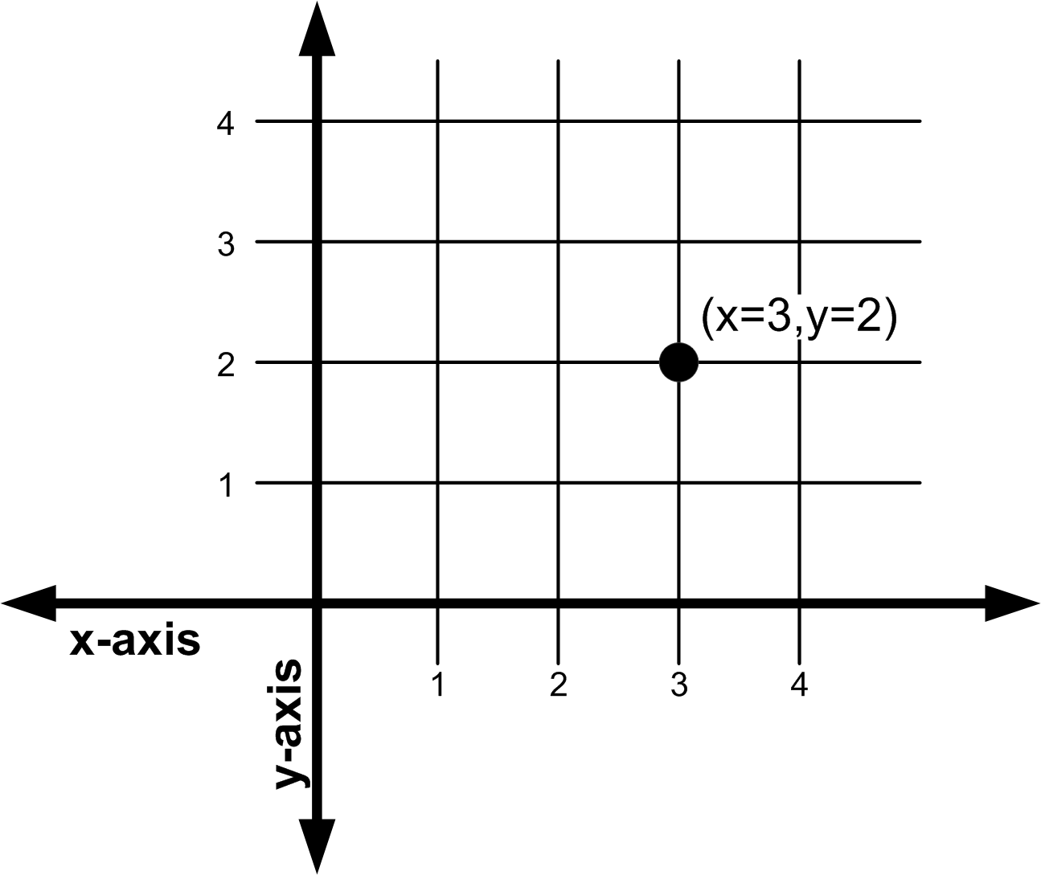
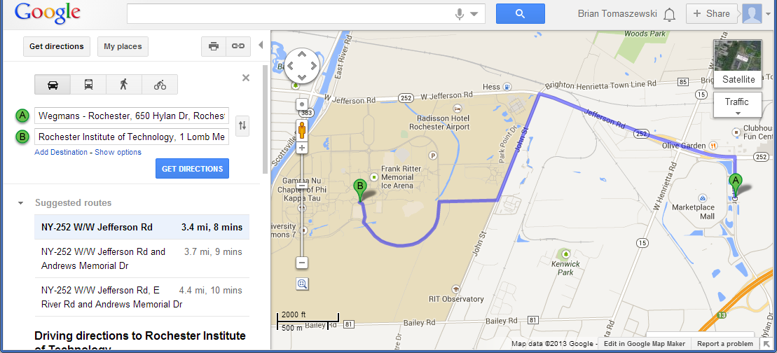
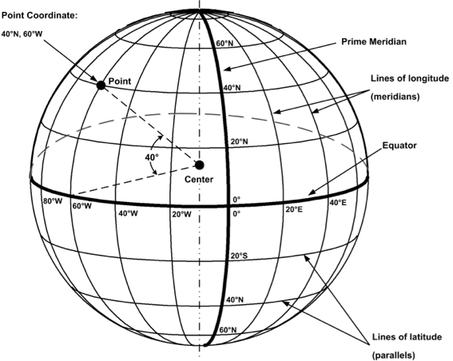
1. Concepts/Knowing about space: Calculating Distance (miles vs. time vs. travel cost, Cartesian vs. spherical)
© 2013 B. Tomaszewski
http://goo.gl/maps/T0rcZ
© 2013 B. Tomaszewski
National Research Council 2006. The Nature of Spatial Thinking. Learning to Think Spatially: GIS as a Support System in the K-12 curriculum. Washington, DC: The National Academies Press.

Slide 48
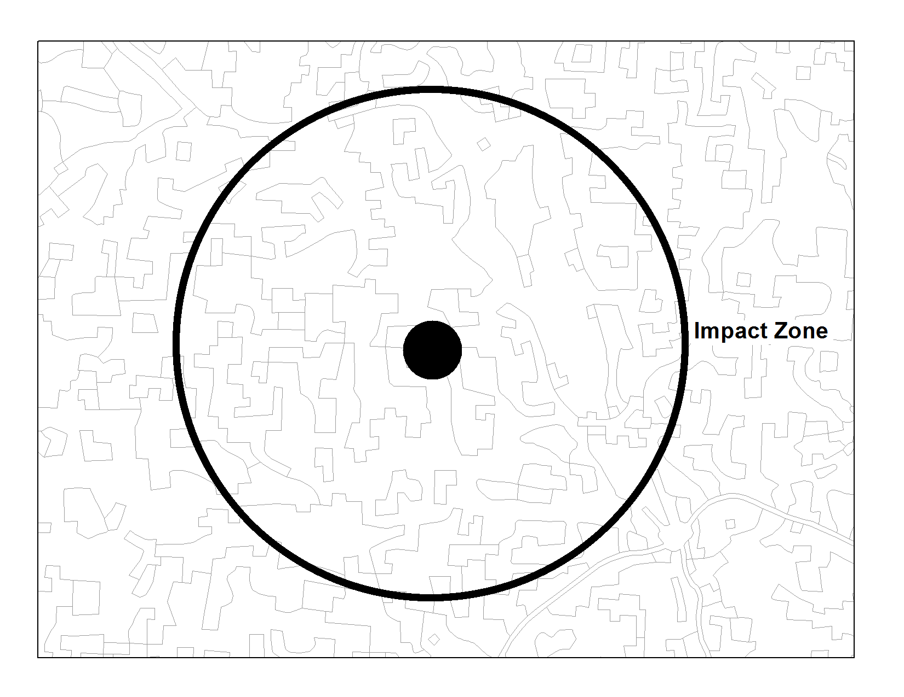
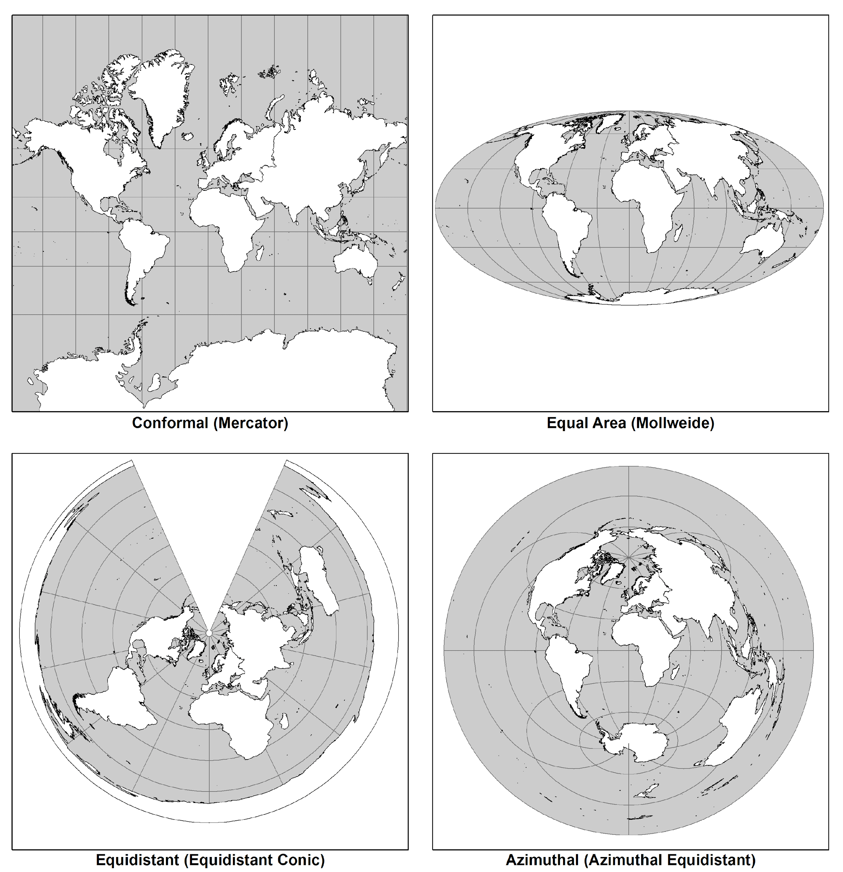

2. Representations – map projection effects/figure ground
© 2013 B. Tomaszewski
© 2013 B. Tomaszewski
© 2013 B. Tomaszewski
National Research Council 2006. The Nature of Spatial Thinking. Learning to Think Spatially: GIS as a Support System in the K-12 curriculum. Washington, DC: The National Academies Press.

Slide 49


3. Reasoning – spatial decisions
What is the slope?
© 2013 B. Tomaszewski
How do I avoid traffic?
National Research Council 2006. The Nature of Spatial Thinking. Learning to Think Spatially: GIS as a Support System in the K-12 curriculum. Washington, DC: The National Academies Press.

Slide 50
Sense of Place
What is Sense of Place?
“A faculty that connects us to the world” – Relph 2001:208
“A well developed sense of place looks carefully at local idiosyncrasies, keeps an open mind about them, and sees through them to larger processes, patterns they signify” – Relph 2001:212
“The village is in the same location I grew up, but really is a different place” – Relph 2001:215

Slide 51



Placelessness
Which one is Rochester?
Modernism – Looking to the future, standardization, ignoring the past
Everything starts looking the same!
Notes:
http://goo.gl/maps/5Uw5L

Slide 52


Postmodernity
“places can look like anywhere developers/designers want them to, usually a function of market research, what attracts consumers, what sells..” - Relph 2001:220
http://esthersteinfeld.files.wordpress.com/2010/05/las-vegas-luxor.jpg
http://upload.wikimedia.org/wikipedia/commons/1/16/Las_Vegas_NY_NY_Hotel.jpg

Slide 53

“It is important to know what belongs, what has been imported and what has been invented in a place” – Relph 2001:221
Pierce Lewis – human-made landscapes valuable clues to culture – investments in time, effort, and money
What does the RIT campus say about RIT culture?

Slide 54
Activity GeoGuesser
https://geoguessr.com
Assignment: After playing around with GeoGuesser write a short writeup on how a sense of place helped you in finding locations in the game.

Slide 55
Readings/Video and To Do
Reading for next week’s class:
Video (1): Geospatial revolution video (13:45) https://youtu.be/poMGRbfgp38
The ArcGIS Book Chapter 1 https://learn.arcgis.com/en/arcgis-book/
Relph_2001_Sense_of_Place
Kimerling_2009
Recommended: Getting to Know ArcGIS Pro 2.6 Chapter 1
To Do: Make Sure You Setup your ArcGIS Online Account from the Email Invitation Sent to you - Email Me if you do not receive the email by Friday

